Slide 1
Membrane Protein Insertion
Dr. Ross Dalbey
580 Bioscience
dalbey@chemistry.ohio-state.edu
Nov 16, 2012

Slide 2
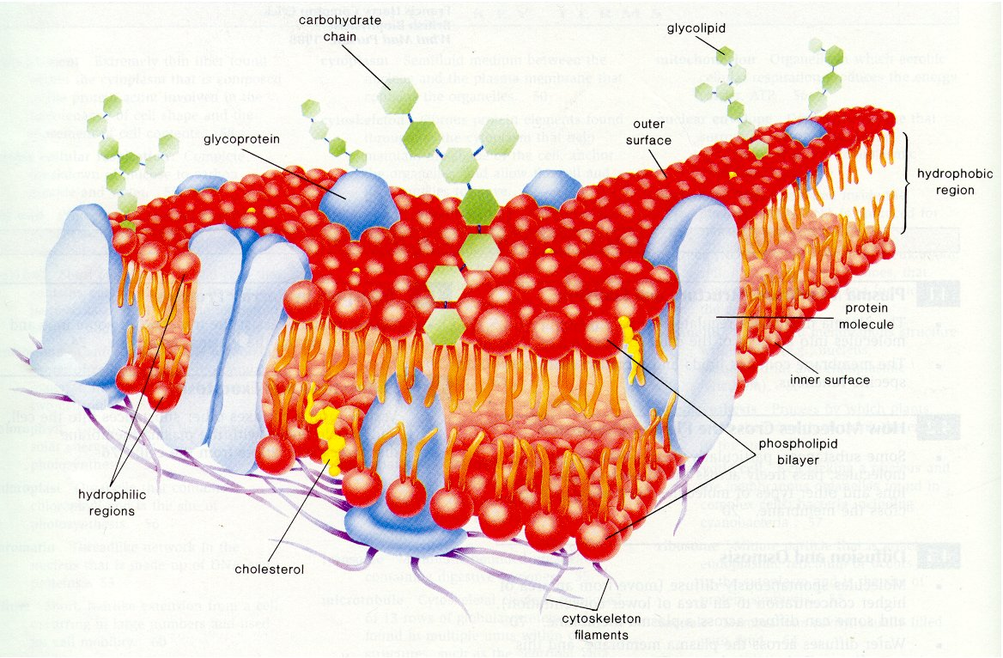
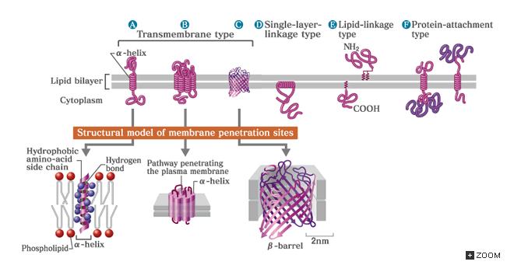
Membrane Proteins
Significance: 25% of proteins in human cells are membrane proteins; membrane proteins make up more than 50% of the known drug targets

Slide 3
Membrane proteins play essential cell functions
energy conversion ATP synthase
energy gain photosynthetic complex
signalling chemosensors
substrate transport permeases
protein translocation translocases
ATP synthase
F₁F_{o}
reaction
center
chemoreceptor
Tar
lactose
permease
LacY
translocase
SecYEG
H⁺
h.ν
Key Question: How do proteins insert into the membrane?

Slide 4
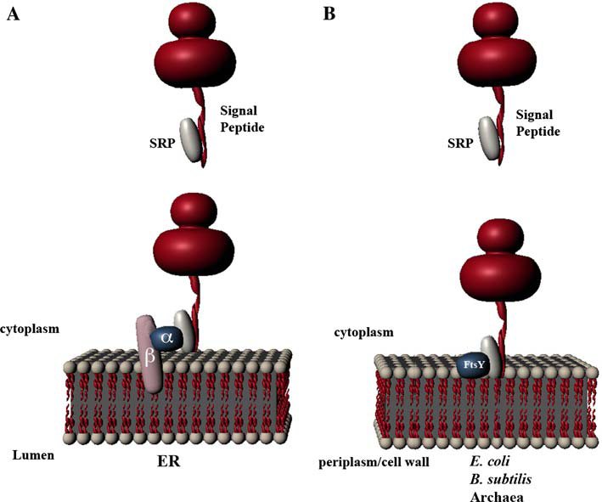
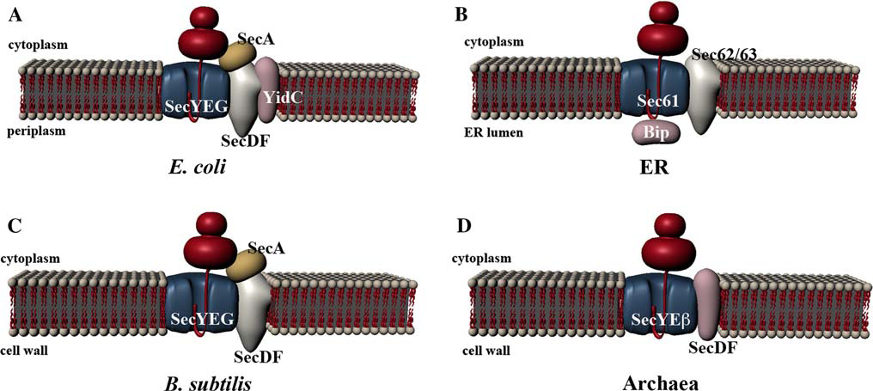
Current Understanding of Membrane Protein Insertion
Different Insertion Pathways: Spontaneous, SRP, Sec Translocase

Slide 5
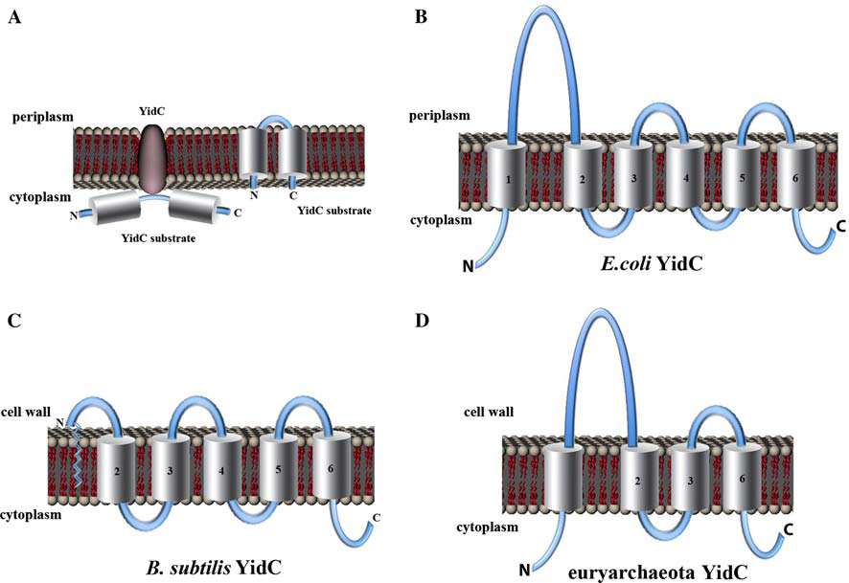
The Discovery of YidC
YidC mediates membrane protein insertion in bacteria
James C. Samuelson¹, Minyong Chen¹, Fenglei Jiang¹, Ines Möller², Martin Wiedmann², Andreas Kuhn³, Gregory J. Phillips⁴ & Ross E. Dalbey¹

Slide 6
Significance
Our objective as scientists is to advance the knowledge of membrane protein insertion in humans.
Humans contain the essential mitochondrial
YidC homolog Oxa1
The essential bacterial YidC is a potential antibacterial target

Slide 7
What we know about YidC and its mitochondrial homology Oxa1p

Slide 8
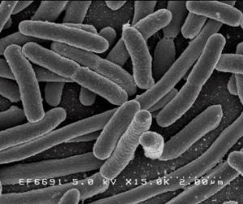
E. coli is used as model system
E. coli has 4485 genes compared to ~ 25,000 in humans

Slide 9
How did we discover YidC is a membrane insertase?
In vivo:
Made a YidC depletion strain and showed insertion
was inhibited

Slide 10
Main Question
Does YidC catalyze membrane insertion?

Slide 11
In vivo

Slide 12
Construction of YidC depletion strain

Slide 13
YidC depletion studies
Grow overnight E.coli culture with arabinose
Wash cells to remove residual arabinose
Back-dilute into LB containing arabinose or glucose
Grow until a significant growth defect is observed (2.5 – 3 hrs)
Switch to minimal media for protein labeling with ³⁵S-methionine

Slide 14
Assay for Membrane Protein Insertion
IM
IM
OM
Lysozyme
Proteinase K
Cyto
Cyto
Peri
Spheroplast
Bacteria
PK
PK
Peri
IM
Cyto
Inserted-Digested by PK
Non-inserted-Resistant to PK
SDS-PAGE
Gel
PK - +
PK - +
Inserted Protein
Uninserted Protein

Slide 15
Effect of YidC depletion on Membrane Insertion

Slide 16
YidC substrate determinants
Function in inserting multispanning membrane proteins
YidC
YidC function: as a foldase or insertase
Structure
The Border region and TM organization

Slide 17
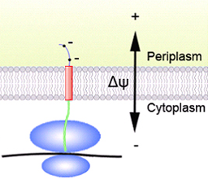
Undergraduate Projects
R447
Defining the Aqueous/ Transmembrane border regions
Kelsey Kerton
E445
P510
F509
I330
L340
Y465
N23
periplasm
L535
L7
Y370
K480
M495
Abdul Wasey
K416
N6
L372
S482
E536
E415
K493
YidC determinants
?
Spontaneous
YidC only
Sec/YidC

